Slide 1
Scrum and Kanban Refresher
Dark Mode Edition

Slide 2
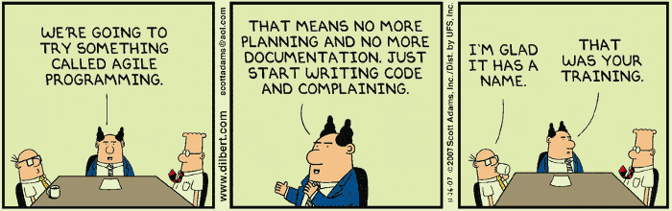
Notes:
Ground rules:
Law of 2 feet
Mute yourselves, please. Feel free to utilize chat – raise your hand/unmute to ask questions. I’ll parking lot anything to the end if we’re running out of time.

Slide 3
What is Agile?
Crystal
Kanban
Lean
Scrum
Feature Driven Development
Extreme Programming (XP)
Agile is an iterative approach to development that helps teams deliver value to their customers faster.
Teams work in small, consumable increments instead of “big bang” releases.
Requirements, plans, and results are evaluated continuously so teams can respond to change quickly.
Notes:
Agile has its roots in Lean Thinking
Management theory that focuses on removing waste and continuous improvement
Agile is a mindset within Lean Thinking that is reflected in Agile Manifesto (We’ll touch on later)
For now the Agile Mindset focuses on the constant delivery of value to our customers.
Agileists strive to deliver functionality to our customers early and often.

Slide 4
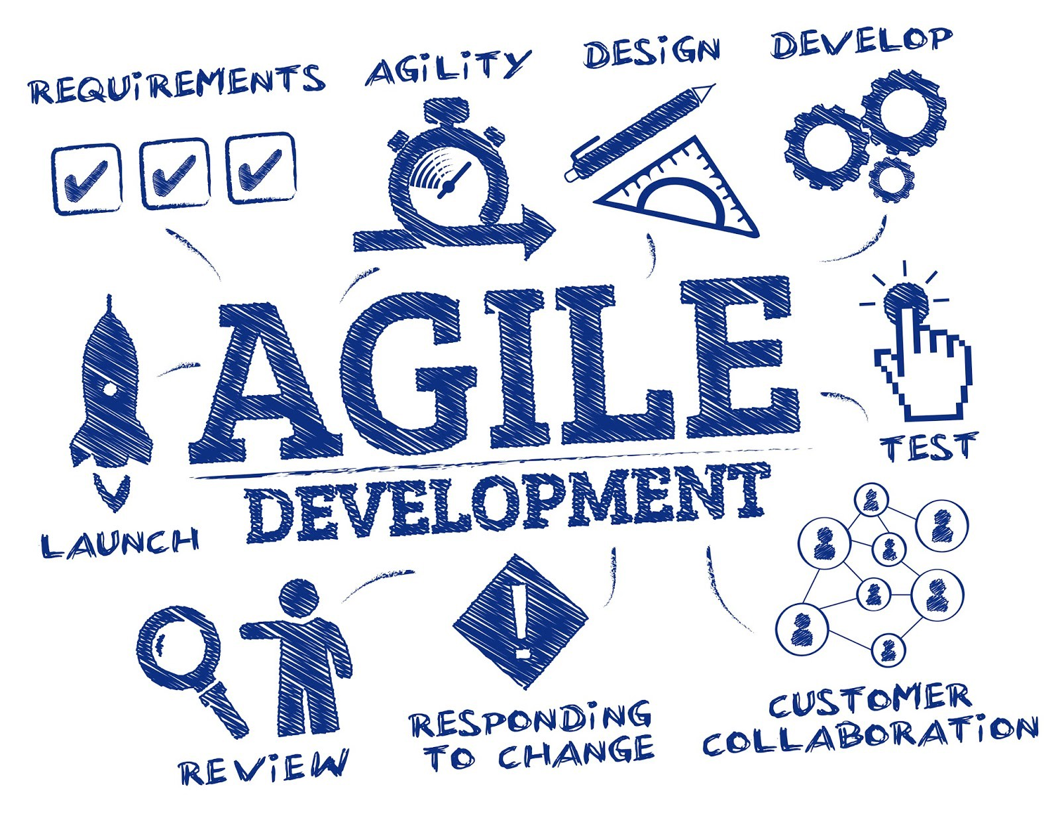
Agile Manifesto
We are uncovering better ways of developing software by doing it and helping others do it. Through this work we have come to value:
Individuals and interactions over processes and tools Working software over comprehensive documentation Customer collaboration over contract negotiation Responding to change over following a plan
That is, while there is value in the items on the right, we value the items on the left more.
Notes:
Snowbird Ski Resort, Utah Feb 2001 – engineers who were tired of outdated development practices. Included representatives from Extreme Programming, Scrum, DSDM, Adaptive Software Development, Crystal, Feature Driven Development, Pragmatic Programming and others. They called themselves “organizational anarchists”

Slide 5
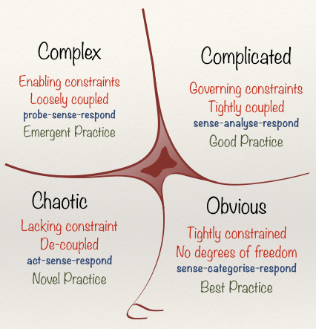
Cynefin Framework
Notes:
Scrum doesn’t work for every situation.
The Cynefin (K-NEV-IN) is a complexity model and sense-making framework, a Welsh word for habitat but it really translates to a “place of multiple belongings”, and used to aid decision-making created in 1999 by Dave Snowden. It offers five decision-making contexts as:
Simple/Obvious,
complicated,
complex,
chaotic, and
disorder
Obvious/Simple:
Cause and effect relationships exist, are predictable and are repeatable.
This type of domain exists is best for reproducing products over and over again since there are steps that you can repeat to solve existing problems.
While Scrum can be a way to address this type of scenario domain, you can achieve faster and more certain results with the assembly line frame work since you have legitimate best practices anywhere.
Sense — See what’s coming in
Categorize — Make it fit predetermined categories
Respond — Decide what to do
Complicated:
Cause and effect relationships exist but are not self evident, and therefore require expertise.
We apply good practice and the approach is to:-
SENSE — ANALYZE — RESPOND
Sense — See what’s coming in
Analyze — Investigate or analyze, using expert knowledge
Respond — Decide what to do
Complicated scenarios are often dominated by experts in order to ensure good practices in a project. Good practice means there are a multiple ways to solve the problem that are all legitimate. While there is a possibility of having multiple answers, having an expert to diagnose problems would be more efficient in addressing scenarios that have multiple possible outcomes. Scrum may be used to resolve scenarios like this, but of course, it may not always be the best framework to use.
Complex:
Cause and effect are only obvious in hindsight, with unpredictable, emergent outcomes.
PROBE — SENSE — RESPOND
Probe — Experimental input
Sense — Failures or successes
Respond — Decide what to do ie. amplify or dampen
This is the domain where Scrum truly shines, since complex situations make use of your ability to probe the situation and inspect what you can do in a particular time-frame. When you learn a better method in the process of iteration, then you can adapt that on the next iteration time-box.
Chaotic:
No cause and effect relationships can be determined. If we enter it deliberately, it’s for innovation, if we enter it accidently then we need to stabilize quickly.
We discover novel practice and the approach is to:-
ACT — SENSE — RESPOND
Act — Attempt to stabilize
Sense — Failures or successes
Respond — Decide what to do next
These kinds of scenarios require a solution right away — when your project goes to the chaotic domain, it means that you are experiencing a crisis that your need to put out before you experience any additional harm and to go back to the state of order. This is the type of scenario that you experience when someone files a lawsuit or the only expert that you know is nowhere to be found.
Scrum is not suitable in addressing these kinds of scenarios since you do not have the luxury to prioritize backlogs and what you need to do during the next situation. When chaos hits, you need to have someone with full authority to take charge and act ASAP.
Disorder:
Space of not knowing which domain you’re in. You’ll interpret the situation according to a personal preference for action.
If you spend much of your time in a bureaucratic process based role, you see all problems as a failure for process. (obvious)
If you’re a deep expert, you see everything as a failure of data/analysis. (complicated)
If you’re a position or general, you bring a bunch of people in from multiple places and experiences and hope that someone can find the answer. (complex)
If you’re a dictator, you love disorder because you can get absolute command and people do what they are told. (chaotic)
Disorder domains happen when you become uncertain of what stage you are in in your project and you do not know if any plans are working or not. This is a very dangerous situation that you need to get out of immediately.
This requires you to break the situation apart and look at its components to know if they fall into any other categories to see what kind of approach you should use to solve the situation and go back to making progress. You can see that there is no point in adapting Scrum in this kind of situation until you properly categorize the components of the problem.
The cliff – boundary between chaotic and simple – you think your past successes mean that you’re bulletproof. You believe things are simple, you believe your own myths – you move to the complacent zone, and you fall over the edge in a crisis. The recovery will be very, very expensive. You should manage in the complicated and complex spaces, and move very few things to the simple domain because you can’t respond as quickly to rapid change.
This model helps us understand what domains we should use to solve a problem.

Slide 6
What is Scrum?
Notes:
Scrum is a lightweight framework that helps people, teams and organizations generate value through adaptive solutions for complex problems. Scrum requires a Scrum Master to foster an environment where:
A Product Owner orders the work for a complex problem into the Product Backlog
The Scrum Team turns a selection of the work into an Increment of value during a Sprint
The Scrum Team and its stakeholders inspect the results and adjust for the next Sprint
Repeat
https://scrumguides.org/docs/scrumguide/v2020/2020-Scrum-Guide-US.pdf#zoom=100
Scrum is easy to understand, hard to do. Founded on empiricism. Empiricism asserts that knowledge comes from experience and making decisions based on what is observed.
Scrum came from rugby lineup. Sprints to a goal, points for a goal – get it? Jeff Sutherland implemented the first Scrum project at the Easel Corporation in 19934. Ken Schwaber and Jeff Sutherland co-presented a paper called the scrum development process at the OOPSLA conference in 1995, and created the Scrum Guide as a framework to apply to business/technology.

Slide 7
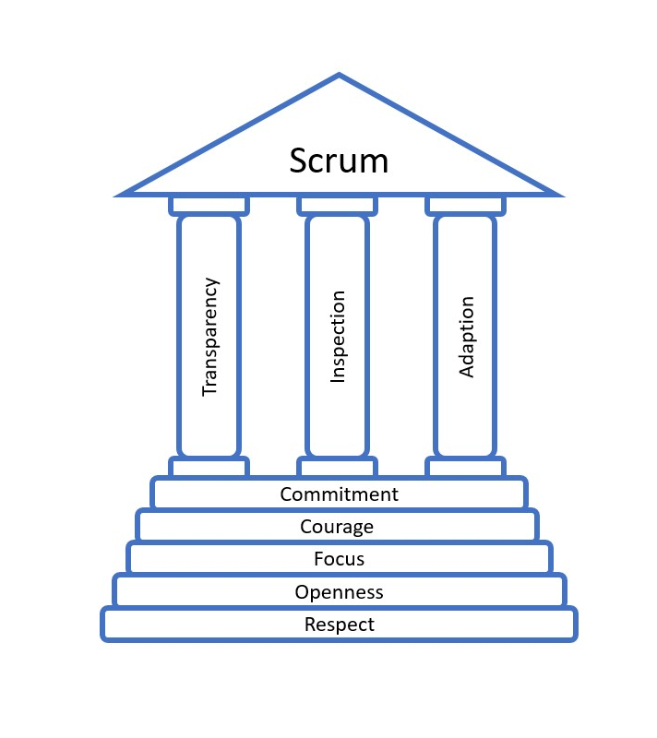
Scrum Pillars and Values
Notes:
Transparency – work must be visible to those performing the work and receiving the work. When there is low visibility, decisions can be made that diminish value and increase risk. “Fail Fast”
Inspection – Progress toward agreed goals and backlogs, product, and process must be inspected frequently to detect potentially undesirable variances or problems. To help with inspection, there are 5 events that happen in a cadence.
Adaptation – If any aspects of a process deviate outside of acceptable limits or the resulting product is unacceptable, the process being applied or materials being produced must be adjusted and must be done quickly. Adaptation becomes more difficult without empowerment of people and self-managing teams. A Scrum Team is expected to adapt the moment it learns anything new through inspection.
--
Mutual team commitment, focus on a goal, openness about what is going wrong/challenges, respect for and from one another, and courage to do the right thing and work on tough problems.

Slide 8
Scrum Roles
Developers
Product Owner
Scrum Master
Notes:
Scrum requires volunteers.

Slide 9
The Scrum Team
10 people or fewer
Scrum Master, Product Owner, and Developers
No sub-teams
Self-Managing, empowered, and long running
Focused on the Product Goal
Accountable for creating a valuable increment every Sprint.

Slide 10

Developers
People in the Scrum Team committed to creating any aspect of a useable increment in each Sprint.
Accountable for:
Creating a plan for the Sprint, the Sprint Backlog
Instilling quality by adhering to a Definition of Done
Adapting their plan each day toward the Sprint Goal
Holding each other accountable as professionals

Slide 11

Product Owner
ONE person who is accountable for maximizing the value of the product.
The PO is accountable for effective Product Backlog management, including:
Developing and explicitly communicating the Product Goal
Creating and clearly communicating Product Backlog items
Ordering Product Backlog Items
Ensuring the Product Backlog is transparent, visible and understood.
Notes:
The Product Owner may do the above work or may delegate the responsibility to others. Regardless, the Product Owner remains accountable. For Product Owners to succeed, the entire organization must respect their decisions. These decisions are visible in the content and ordering of the Product Backlog, and through the inspectable Increment at the Sprint Review.
The Product Owner is one person, not a committee. The Product Owner may represent the needs of many stakeholders in the Product Backlog. Those wanting to change the Product Backlog can do so by trying to convince the Product Owner
Great Product Owners give things to customers before they want it.

Slide 12

The Scrum Master
The Scrum Master is accountable for the Scrum Team’s effectiveness. They serve the team and the organization by:
Coaching teams in self-management and cross-functionality
Helping Scrum Team focus on creating high-value increments that meet the DOD
Causing the removal of impediments
Ensuring Scrum events take place and are productive and within the timebox
Finding techniques for effective product backlog management
Facilitating stakeholder collaboration
Coaching and leading the org in Scrum adoption

Slide 13
Scrum Events
The Sprint
Sprint Planning
Daily Scrum
Sprint Review
Sprint Retrospective

Slide 14
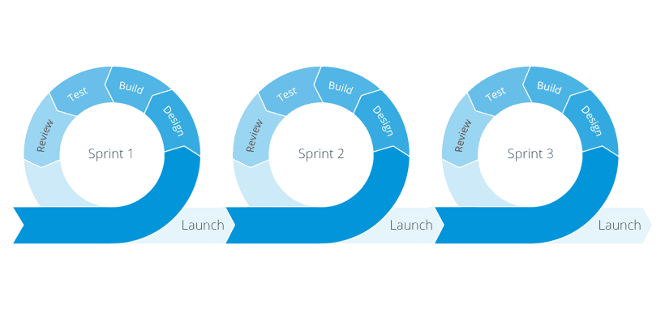
The Sprint
1-4 weeks in length
During the sprint:
No changes are made that would endanger the sprint goal
Quality does not decrease
The product backlog is refined as needed
Scope may be clarified and renegotiated with PO as more is learned
A Sprint could be cancelled if the Sprint Goal becomes obsolete. Only the Product Owner has the authority to cancel the Sprint.

Slide 15
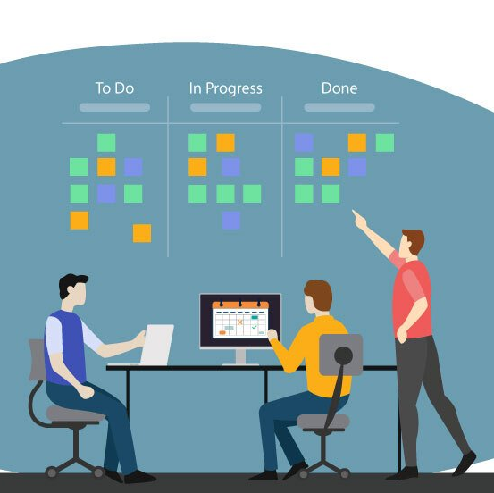
Sprint Planning
By the end of the sprint I want to…
What can be Done this Sprint?
How will the chosen work get done?
Sprint Planning is timeboxed to a maximum of eight hours for a one-month Sprint. For shorter Sprints, the event is usually shorter.
Notes:
“everyone has a plan until they get punched in the face” – Mike Tyson

Slide 16
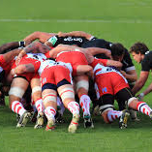
Daily Scrum
15 minute event meant to be a planning meeting for the team.
Inspect progress toward Sprint Goal and coordinate as a team on how to accomplish the goal.

Slide 17
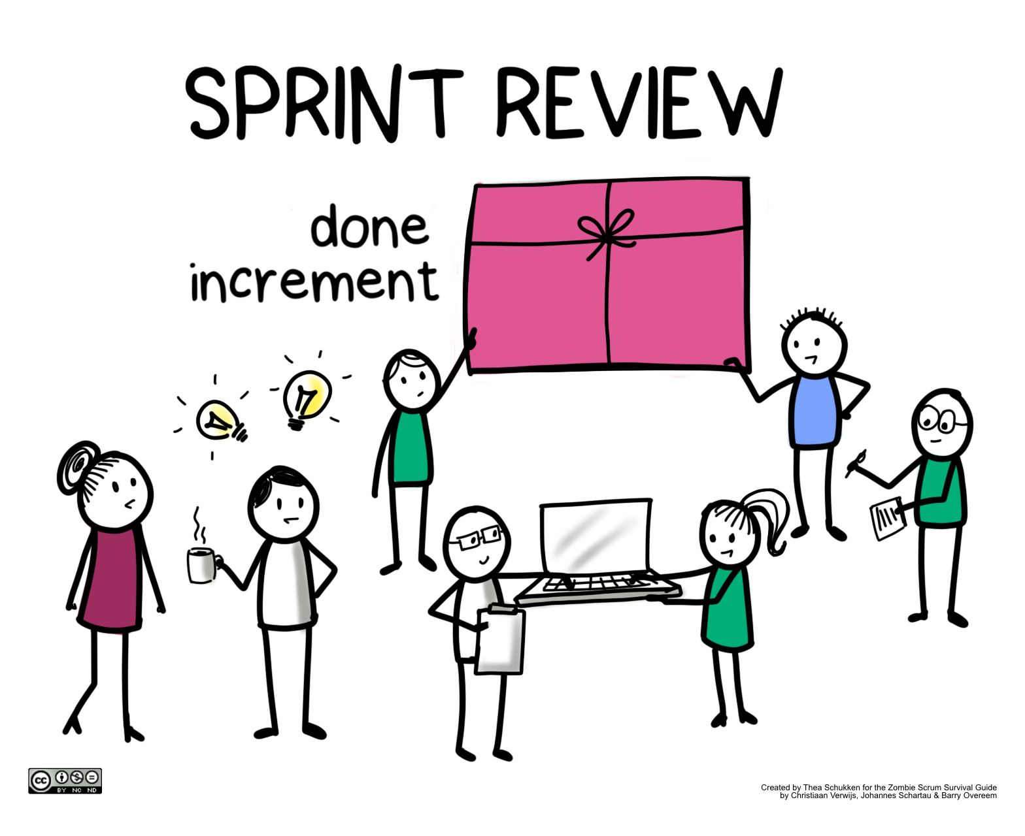
The Sprint Review
Inspect the outcome of the Sprint and determine further adaptations.
Present results of the Sprint to key stakeholders and progress to toward the Product Goal.
Adjust the backlog as needed.
Sprint Review is a WORKING SESSION and not a presentation.
Timeboxed to a maximum of four hours for a one month sprint.

Slide 18
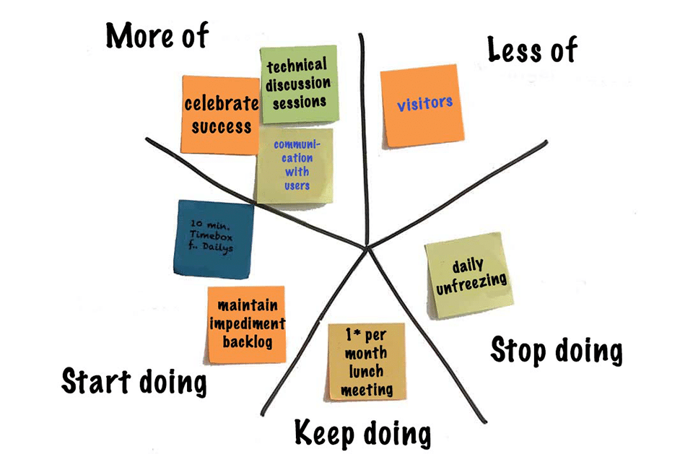
Sprint Retrospective
Adjustments to the team’s Working Agreement
What happened?
So, what?
What now?
Measurable
Better or worse?
Maximum of 3 hours for a one month sprint.
Notes:
We will always act as if we believe everyone did the best job they could do with the information at the time.
Team members OWN the change.
Good retros take pre-work.

Slide 19
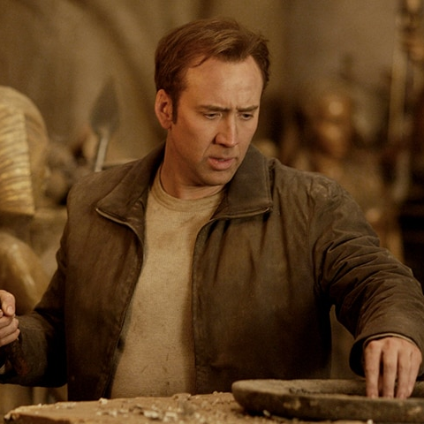
Scrum Artifacts
Product Backlog
Sprint Backlog
Increment

Slide 20
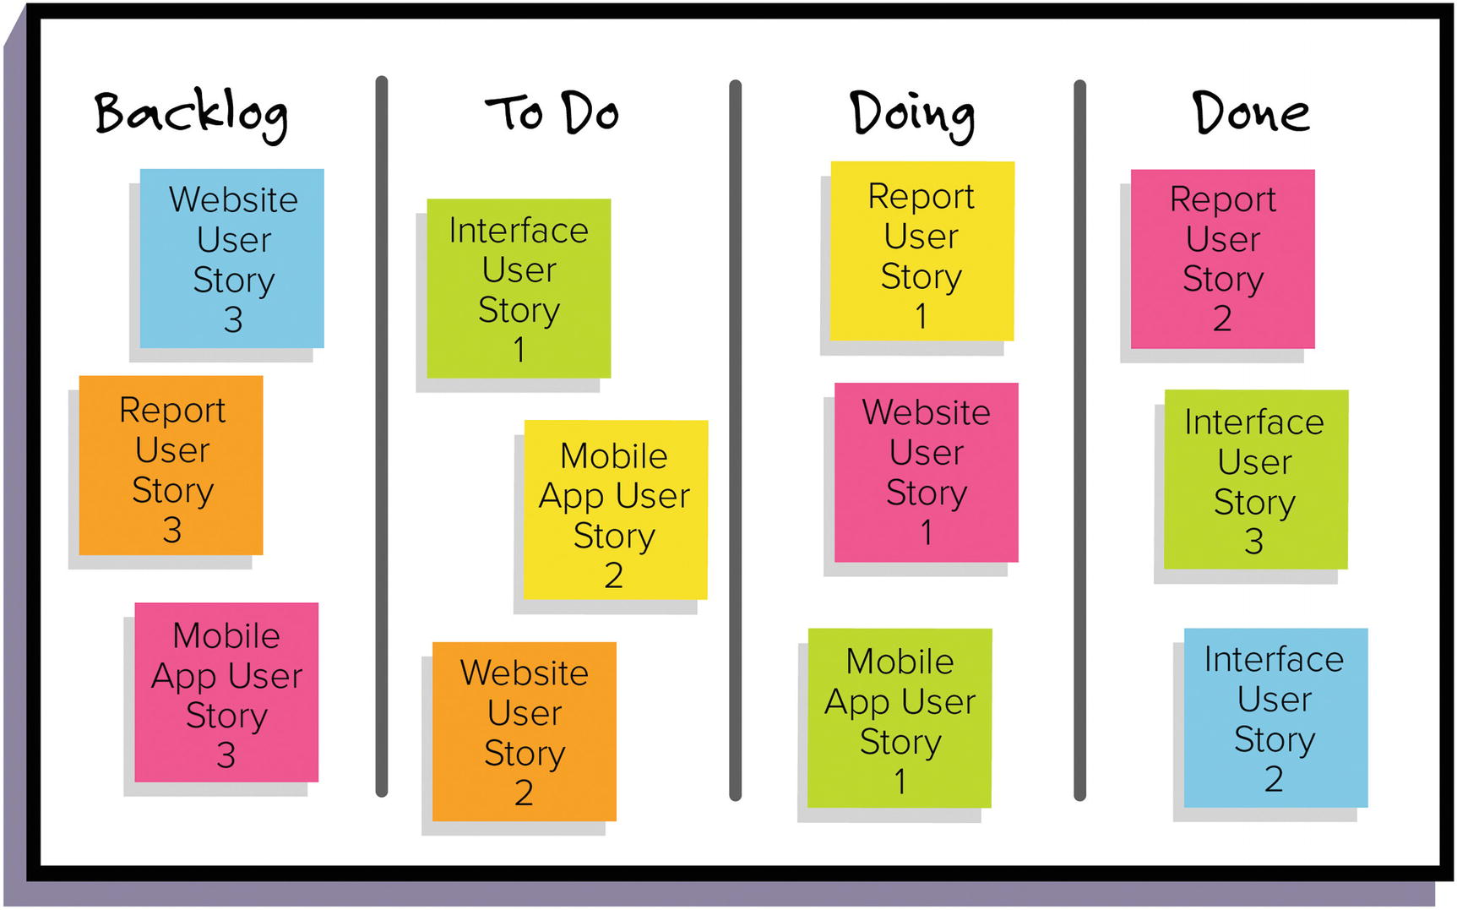
Product Backlog
An ordered list of all desired work on the project
Ideally expressed such that each item has value to the users or customers of the product
Prioritized by the Product Owner
Reprioritized at the start of each sprint
Estimated by the Developers
Commitment: The Product Goal

Slide 21
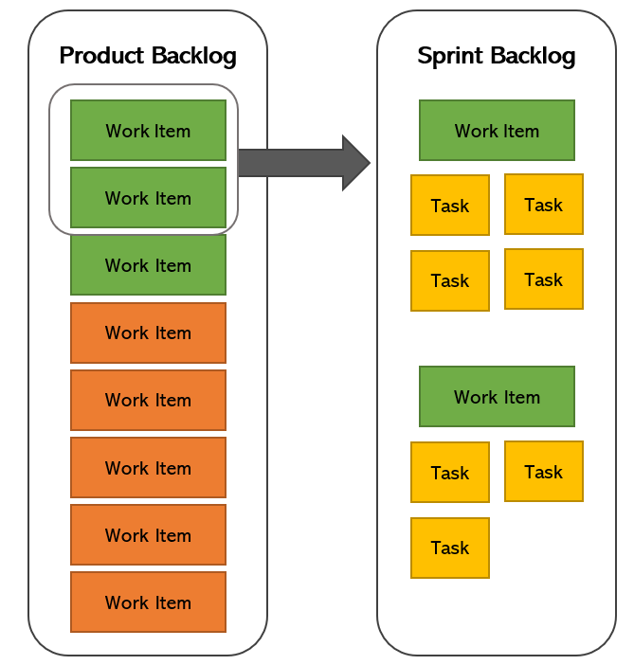
The Sprint Backlog
Sprint Backlog is composed of Sprint Goal (why) and items selected for the Sprint (what), with an actionable plan of delivering the Increment (how).
Individuals sign up for work of their own choosing
Work is never assigned

Slide 22

The Increment!
Recent things we’re building.
Potentially shippable.

Slide 23
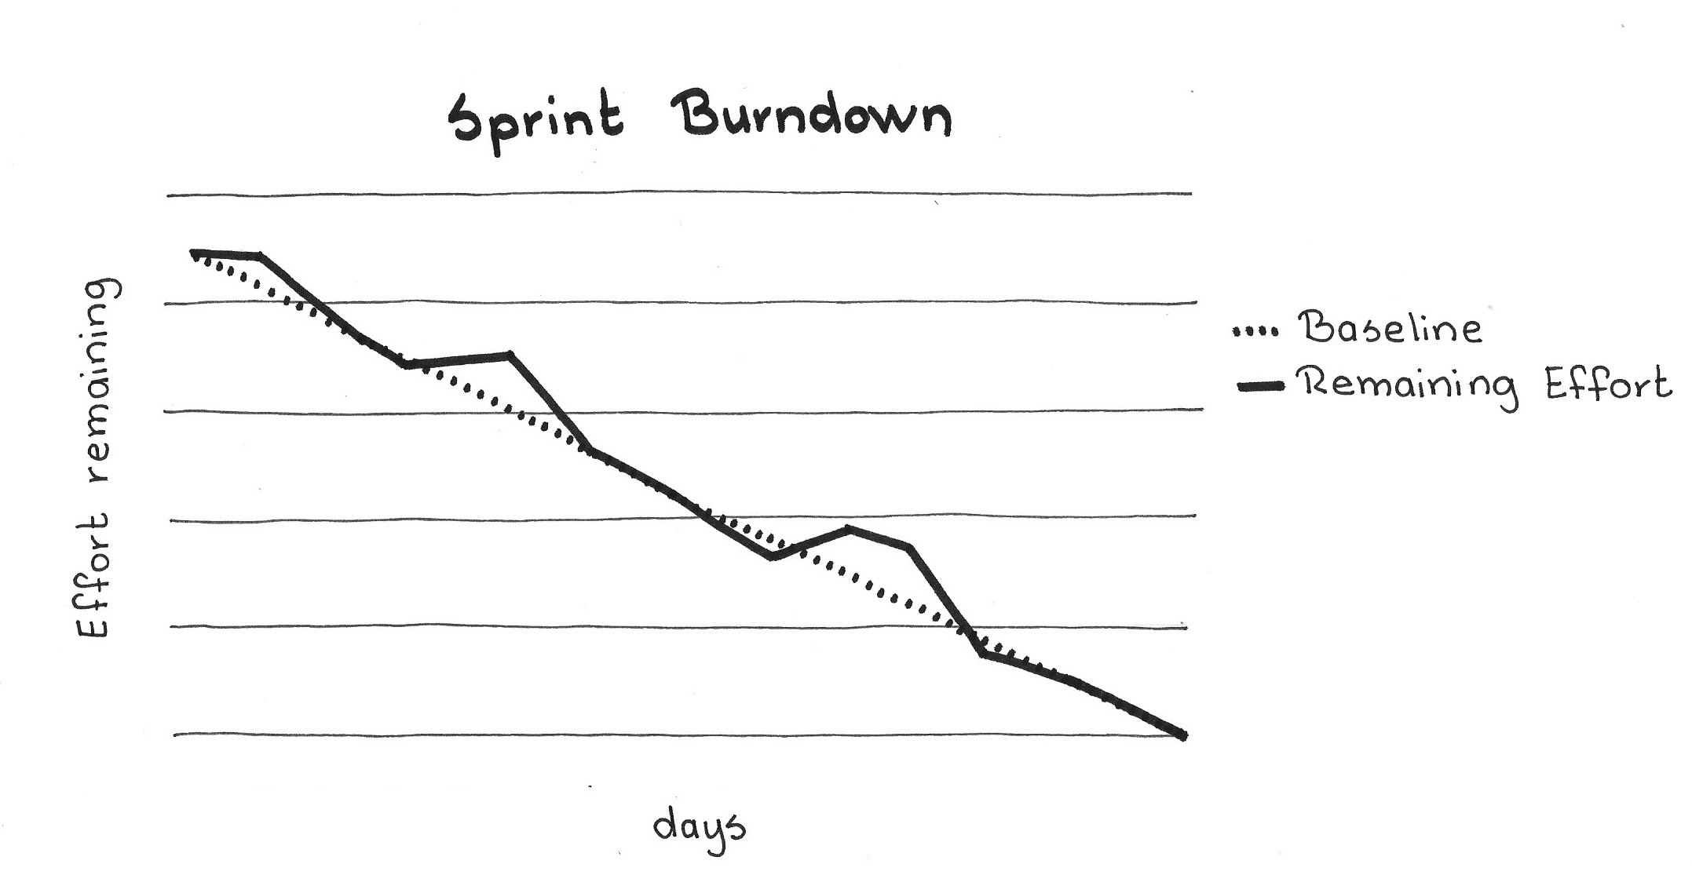
Other “Unofficial” Artifacts
Sprint Goal
Product Goal
Definition of Done
Working Agreement
Graphical displays of progress
User Stories
Notes:
If you leave something out of your DOD you’re borrowing from the future. What’s the interest rate?
Test everything every time.
Effort to test increases at an increasing rate
Refactor every sprint to get good end product/structure. Change internal design without changing external feature. The key to this is automated tests.
Points – defects = unsuccessful sprint
---
User stories:
Conversation, card, confirmation
Bring me a rock

Slide 24
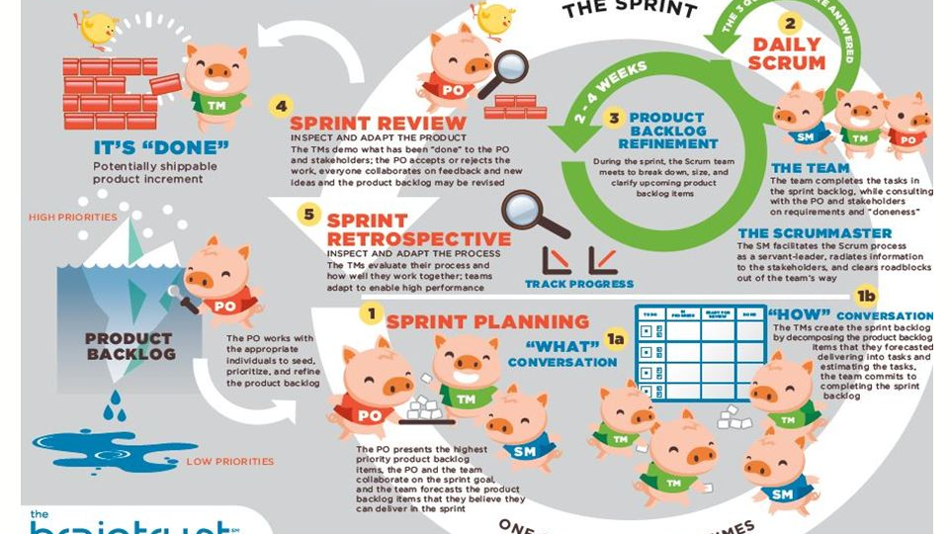

Slide 25
Kanban Overview
Notes:
In 1940 a Toyota engineer, Taiichi Ohno, created a system that used paper cards for signaling and tracking demand in his factory and named the system Kanban. The way items were restocked in the marketplaces inspired Taiichi. If there are empty shelves in the shop then more inventory is ordered to meet the demand again.
Taiichi brought this JIT (just-in time) principle to the Toyota facilities to ramp up the car development process.
In 2004 David J Anderson was the first to apply Kanban to IT.

Slide 26


A Pull System
Notes:
In an ideal world, things would flow from one machine to another seamlessly. But what if machine one is faster? Then you have things piling up before the next machine can process it. This WIP is a problem, because there’s cost, the floor space has to be paid for. WIP buildup can hide issues like downtime ,set up time, and defects. If you reduce WIP, you can see those problems more easily.
To fix this, you reduce WIP by having the first machine only produce items once machine 2 is ready to receive them. The way you do this is with the Kanban card to signal to machine 1 that machine 2 is ready.

Slide 27
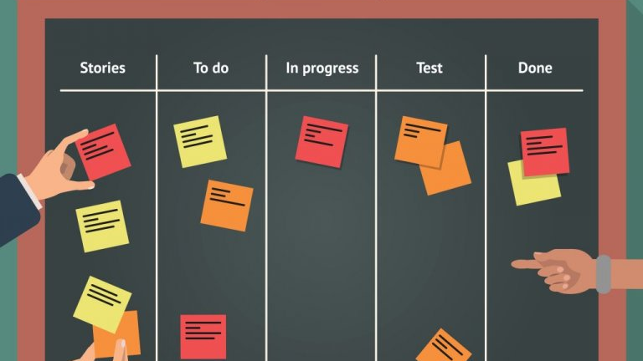
Kanban Board
Notes:
In software, we do this through processes/workflow and tasks. In Kanban, you show these things on a Kanban board to readily see where the work is and how much work is in progress. The pull system is implemented by a nearly empty or empty column signaling to the column before that it’s ready for more work. This leads to shorter cycle time, increased throughput and less wasted time.
The team cannot take on more work than is available according to their WIP limits for each column. This leads to team members working together to complete in progress tasks and shows teams where their bottlenecks are and can help teams discover things to automate or other areas of improvement. The easiest way to reduce bottlenecks in a column is to limit the Work in Progress earlier in the flow. Flow itself is a critical component of Kanban, and means that cards should flow through the system as evenly as possible, without long wait times or blockages. Everything that hinders the flow should be critically examined.

Slide 28
Kanban Practices
Visualize the flow of work
Limit WIP (Work in Progress)
Manage Flow
Make Process Policies Explicit
Implement Feedback Loops
Improve Collaboratively, Evolve Experimentally
Notes:
Kanban focuses on maintaining continuous task flow and continuous delivery. At the same time, the team is never given more work than it can handle. This is accomplished through two primary principles of Kanban: Visualize your work, limit work in progress.
Visualizing the flow of work is accomplished by mapping the steps you take to deliver work and creating a Kanban board that reflects it.
Decide your WIP limits. This can be done by initially having no limits, and then observing the initial WIP as your team starts to use Kanban. Once you have data, define WIP limits for each state of the workflow as being equal to half the average WIP. Many teams start with a WIP limit of 1 to 1.5 times the number of people working in a specific stage.
Manage flow: You can do this by highlighting the various stages of the workflow and the status of work in each stage. Depending on how well the workflow is defined and the WIP limits are set, you will observe either a smooth flow within WIP limits or work piling up as something gets held up and starts to hold up capacity. This affects how quickly work can go from start to end. Kanban helps the team analyze the system and make adjustments to improve flow as to reduce the time it takes to complete each piece of work. An important part of this process is to look at the intermediate wait stages and see how long work items stay in these “handoff stages.” Reducing the time spent in these wait stages is the key to reducing cycle time. As you improve, work will become more predictable and easier to make reliable commitments.
Make the process explicit: Write down your policies for how you do the work! This creates a shared understanding of how work gets done within your team. Think about this as a definition of done for each column and guidelines of when something can move from one column to the next, or who pulls what when.
Implement Feedback Loops: Review stages in your Kanban board flow, review metrics and reports that give us information on how we’re doing. Fail fast! Get feedback quickly from stakeholders and apply learning.
Improve collaboratively, evolve experimentally: adopt small changes and improve gradually at the pace that your team can handle easily. Use the scientific method – form a hypothesis, test it, and make changes. Measure the change and adjust.

Slide 29
Scrum vs. Kanban
Scrum – more structured, emphasizes teamwork, accountability and iterative progress toward a well defined goal.
Kanban – a bit more flexible, visual system for managing work as it moves through a continuous process.

Slide 30
In Summary…
 | Scrum | Kanban
Cadence | Fixed length sprints | Continuous flow
Release Methodology | Possibly at the end of each sprint | Continuous delivery
Key Metrics | Velocity, burn down, burn up | Lead Time, Cycle Time, WIP, CFD
Roles | Product owner, scrum master, developers | No required roles
Teams | Must be cross-functional | Can be specialized
Modifications | Changes during the sprint are strongly discouraged | Change can happen at any time
WIP Limits | Limits work in progress per iteration | Limits WIP by limiting the number of cards in any active-work columns
Commitment | Teams are required to commit to a specific amount of work | Commitment is not necessary
Storyboard | Scrum board is re-set after every sprint | Kanban board is persistent and continues for as long as the project continues

Slide 31
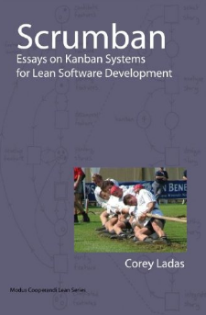
ScrumBan
Visualize the work
Stop early binding (don’t assign work to people at the beginning)
Impose WIP limits
Swap push for pull by adding buffer columns between process stages (Dev: In Progress | Done)
Prioritize work with a Ready column
Stop estimating and start breaking work down
Trigger Planning: Plan when work is needed.
Notes:
Scrumban was created by Corey Ladas. He believed Scrum could be improved if you apply Kanban principles
Corey set this up for teams currently using Scrum, but I think Scrumban is also possible to use for teams who are just getting started with Agile or for teams who are doing Kanban who want to try and use Scrumban.
Applying Kanban principles to Scrum while following the Scrum Guide.
Trigger planning – find a line in the “to do” part of your Kanban that signals it’s time to plan more work.

Slide 32
Kanban/Lean References & Resources
Scrumban – Corey Ladas
Kanban - David J Anderson
Kanban in Action - Marcus Hammarberg and Joakim Sunden
The Toyota Way – Jeffrey K Liker
The Goal: A Business Graphic Novel – Dwight Jon Zimmerman
Value Stream Mapping – Karen Martin and Mike Osterling
Development That Pays – Youtube Channel

Slide 33
Scrum References and Resources
The Scrum Guide - Jeff Sutherland and Ken Schwaber
Essential Scrum: A Practical Guide to the Most Popular Agile Process - Kenneth Rubin
Scrum and XP from the Trenches - Henrik Kniberg
Succeeding with Agile: Software Development using Scrum - Mike Cohn
Scrum: The Art of Doing Twice the Work in Half the Time – Jeff Sutherland
Serious Scrum – A Medium Article collection
Agile Product Ownership in a Nutshell – Henrik Kniberg, Youtube
Agile Retrospectives – Ester Derby and Diana Larsen

Slide 34
Other References and Resources
The Agile Manifesto
Agileleanhouse.com.url – A collection of agile resources
The Phoenix Project – Gene Kim
User Story Mapping – Jeff Patton
(Re)Learning Leadership Podcast
The Cynefin Framework – David Snowden (Youtube)
The Pragmatic Programmer- David Thomas and Andrew Hunt

Slide 35
Q&A

